Slide 1
Optical Dispersion

Slide 2
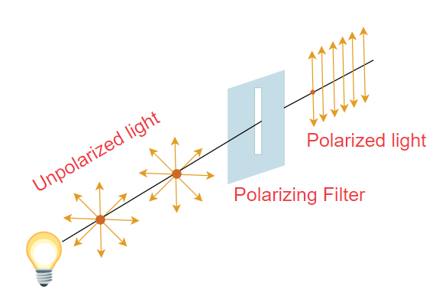
Plane Polarized Light
Plane polarized light is light where the electric field oscillates in only one direction or plane. Ordinary light is turned into plane-polarized light by passing it through a lens made of the material known as Polaroid or more traditionally through pieces of calcite.

Slide 3
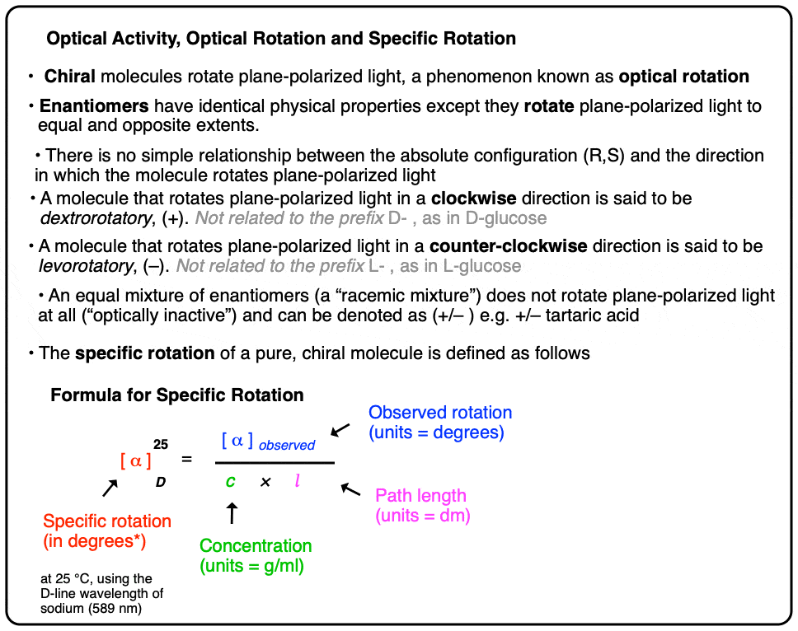

Slide 4
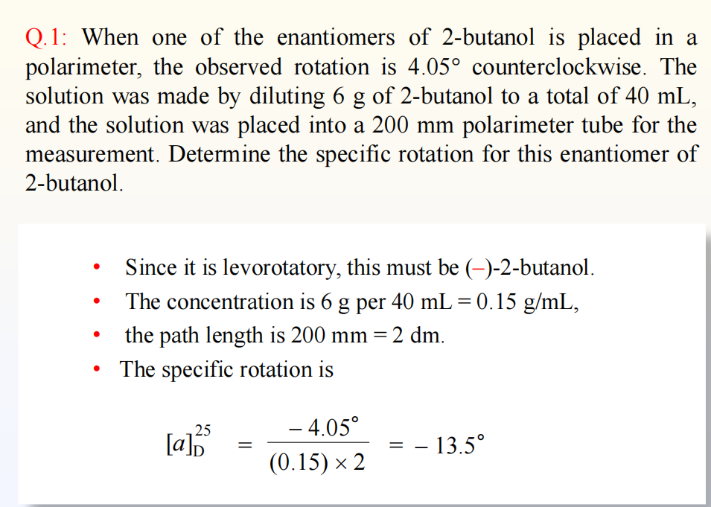

Slide 5
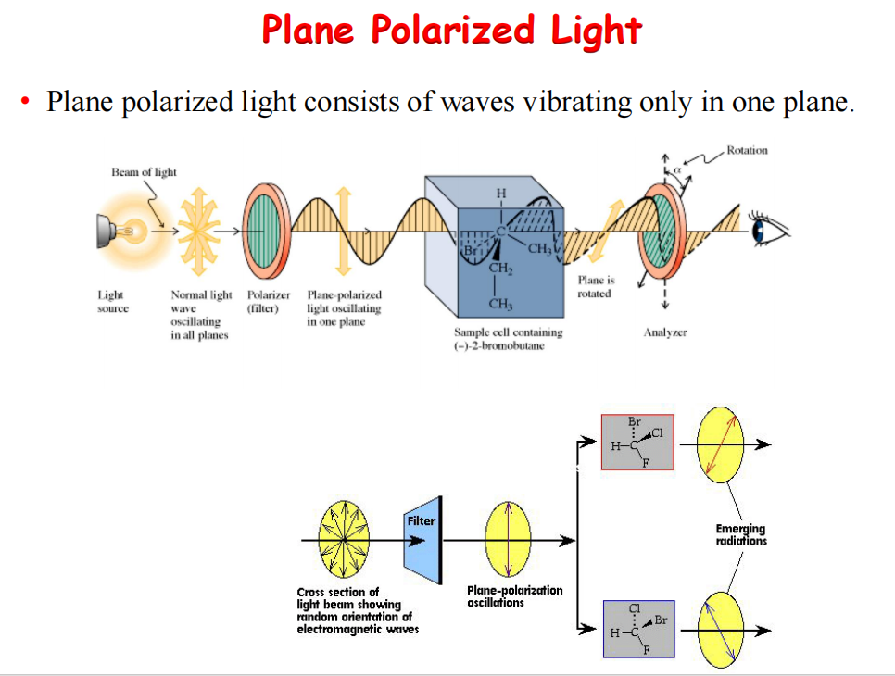

Slide 6
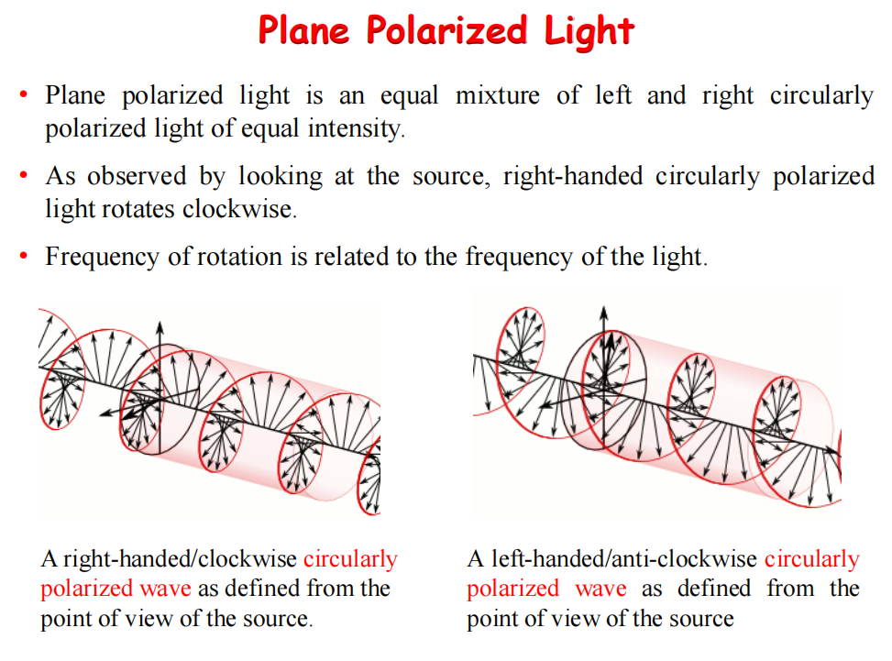

Slide 7
Types of Polarization of Light
The three types of Polarization based on transverse and longitudinal wave motion are as follows:
Linear polarization
Elliptical Polarization
Circular Polarization
Linear Polarization
In linear polarization, the electric field of light is restricted to a single plane along the direction of propagation.
Circular Polarization
In circular polarization, the electric field has two linear components that are perpendicular to each other such that their amplitudes are equal, but the phase difference is 90 °. The resulting electric field rotates in a circle around the direction of propagation. Depending on the rotation direction, it is called left- or right-hand circularly polarized light
Elliptical Polarization
In elliptical polarization, the electric field has two linear components that are perpendicular to each other. However, either their amplitudes are not equal, or their phase difference is not 90°.

Slide 8
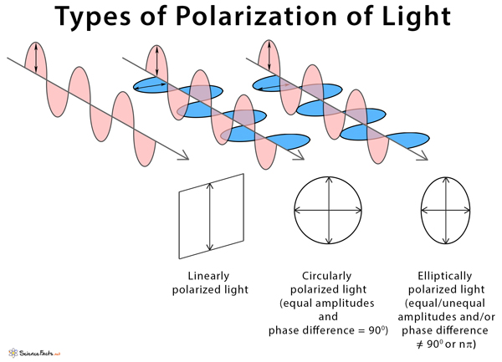

Slide 9
Circular and elliptical polarization are both types of electromagnetic wave polarization where the electric field vector rotates.
The difference is that circular polarization occurs when the two perpendicular, linearly polarized component waves have equal amplitude and a 90° phase difference, resulting in a constant-magnitude circular rotation.
In contrast, elliptical polarization occurs when the component waves have either unequal amplitudes or a phase difference other than 90°, causing the vector to trace an ellipse and its magnitude to change over time

Slide 10
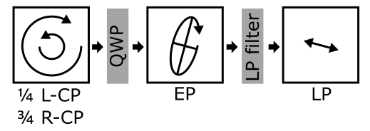

Slide 11
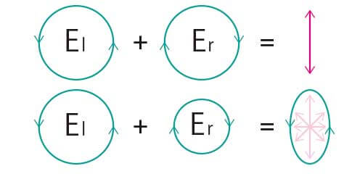
Linear polarization is obtained by passing light through an optical element (polarizer) in which the crystal axes and the orientation of the molecules are aligned. Circular polarization occurs when the phase of an orthogonal wave vector (electric field vector) deviates by 1/4 wavelength. Circularly polarized light can be left-handed (El) and right-handed (Er), and linearly polarized light can be treated as the sum of E l and E r of equal intensity (Fig. , upper). When E l and E r have different intensities, the resulting light is referred to as elliptically polarized (Fig.lower).
Fig. Sum of circularly polarized light components
El = Er： linearly polarized light (upper)
El ≠ Er：elliptically polarized light (lower)

Slide 12
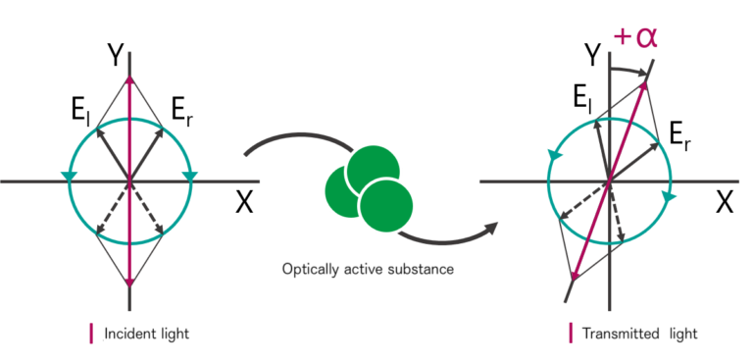
Optical rotation and principle of ORD measurements
Optically active substances are molecules that have mirror images with L- and D-forms. Examples of such molecules are thalidomide and glyceraldehyde. Such substances cause a rotation of the polarization plane of linearly polarized light, referred to as optical rotation (OR). The wavelength dependence of OR is called optical rotational dispersion (ORD).
As shown in Fig. , when light that is linearly polarized along the Y-axis has its polarization plane rotated to the left, this is referred to as levo (l) or (-) optical rotation. When the rotation is to the right, it is referred to as dextro (d) or (+) optical rotation. The rotation angle is given by α, which can be positive or negative.

Slide 13
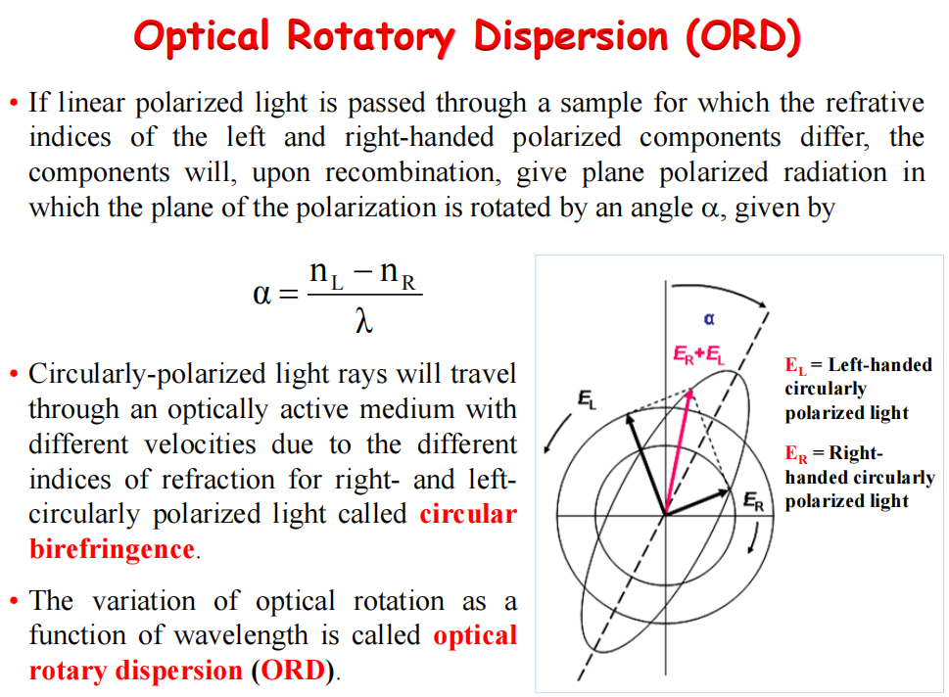

Slide 14
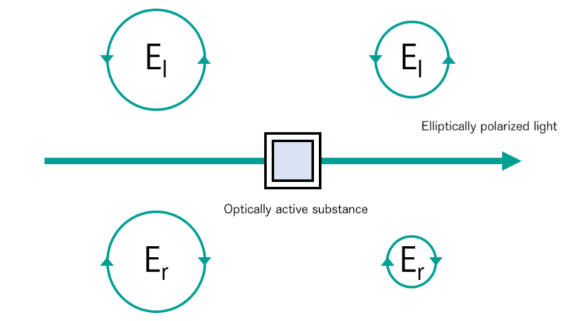
Principles of CD measurement
Circular dichroism (CD) is a phenomenon in which the degree of absorption of left and right circularly polarized light is different in the absorption wavelength range of optically active substances. CD measurements detect these differences by passing left and right circularly polarized light through an optically active sample. The transmitted light is then elliptically polarized, and this phenomenon is called circular dichroism (CD) and is expressed by the ellipticity θ (Fig.). A plot of the wavelength dependence of this ellipticity is called a circular dichroism spectrum (CD spectrum).
Fig. : Principles of CD：unequal absorption of circularly polarized light

Slide 15
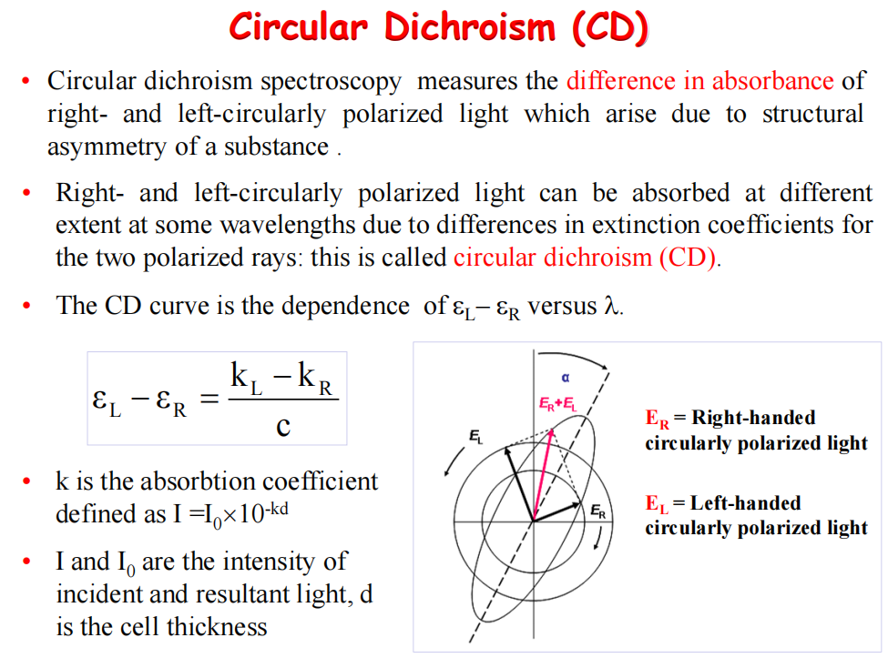

Slide 16
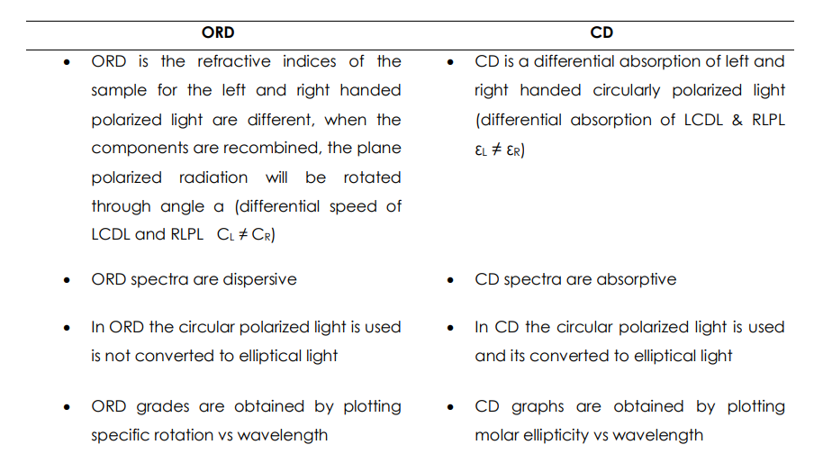
Difference between ORD and CD

Slide 17
Application of ORD curve
It helps to determine the relative configuration of chiral compounds.
It helps in the determination of Configuration and study of compound conformational change.
It helps in the analysis of the functional group and determination of the position of the functional group.
It helps in the structural determination of polypeptide and protein.

Slide 18
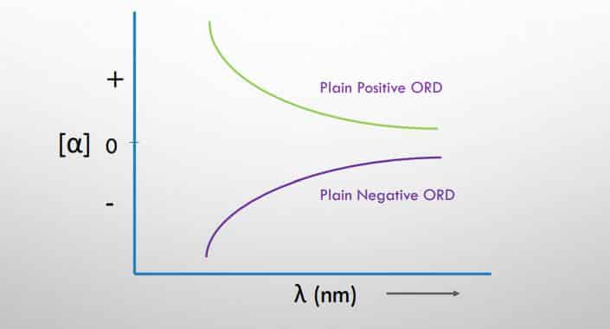
The optical rotatory dispersion curve are classified into two main types and they are:
Plain curve
Cotton effect Curve
Plain curve
The term “plain curve” refers to an optical rotation that steadily increases or decreases as wavelengths away from the maximum absorption wavelength, crossing or not crossing the zero rotation line. When the rotation increases as the wavelength decreases, the curve is termed positive; when the rotation decreases as the wavelength decreases, the curve is called negative.

Slide 19
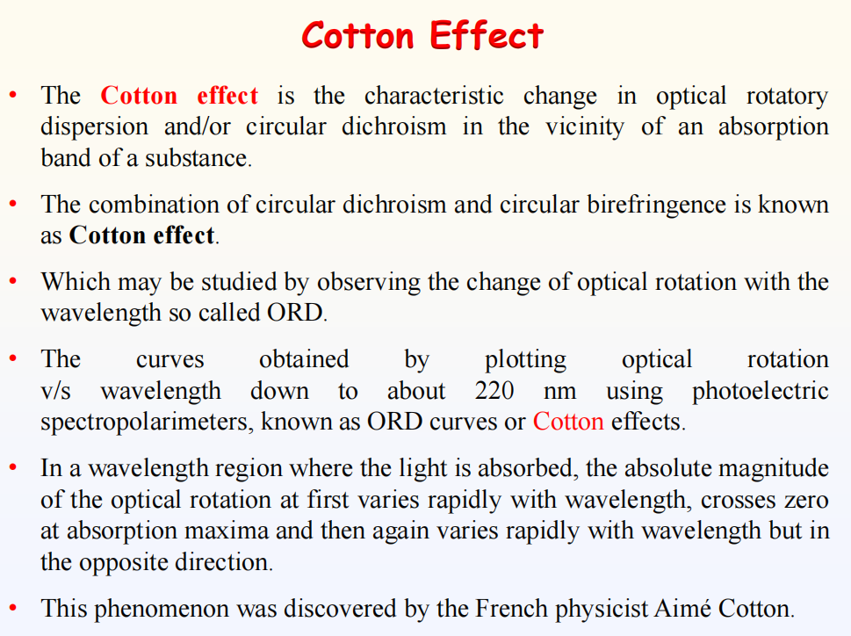

Slide 20
Cotton effect curve
Cotton effect curves are also known as anomalous dispersion of optical rotation. Cotton effect curves are obtained for the compound with asymmetric carbon and chromophore which absorbs near UV region. Cotton effect curves are mainly classified into two types:
Single cotton effect curve
Multiple cotton effect curve
Single cotton effect curve
At maximal absorption, the cotton effect curve exhibits both the maximum and the minimum curve. Positive cotton effect occurs when the crest first passes through the trough and moves toward the cotton effect region and negative cotton effect occurs when the trough moves first through the crest and moves toward the cotton effect region. The vertical distance between crest and trough is called amplitude.

Slide 21
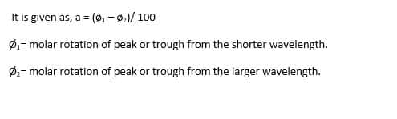
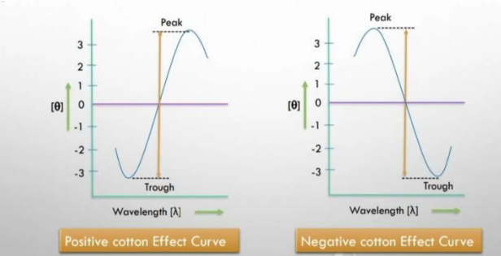

Slide 22
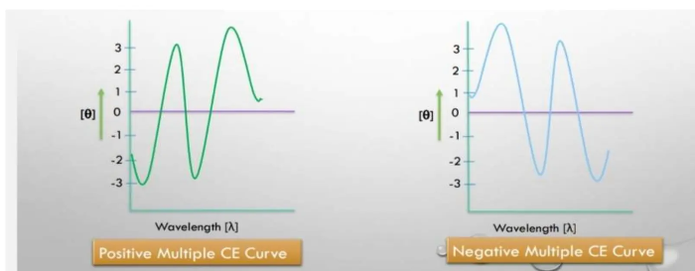
Multiple cotton effect curve
Multiple cotton effect curve is the combination of a number of single cotton effect curves. It is more complex than a single cotton effect curve. This curve result from the electronic transition of many Chirotropic chromophore presents in a molecule.

Slide 23
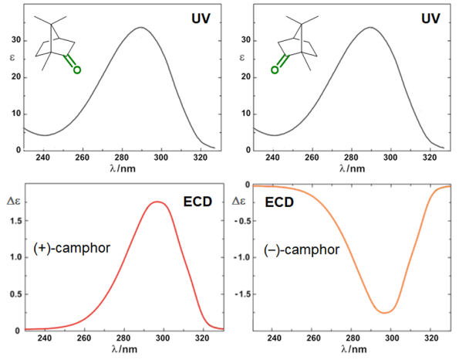
UV and CD of Camphor

Slide 24
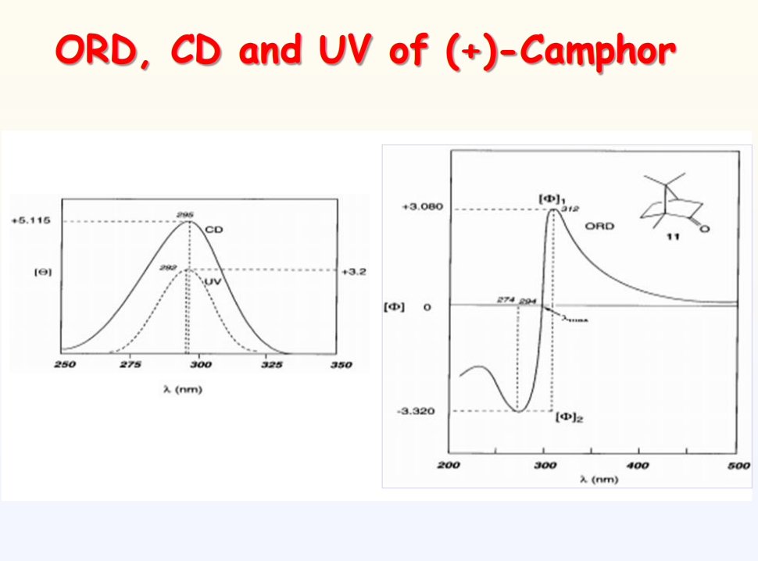

Slide 25
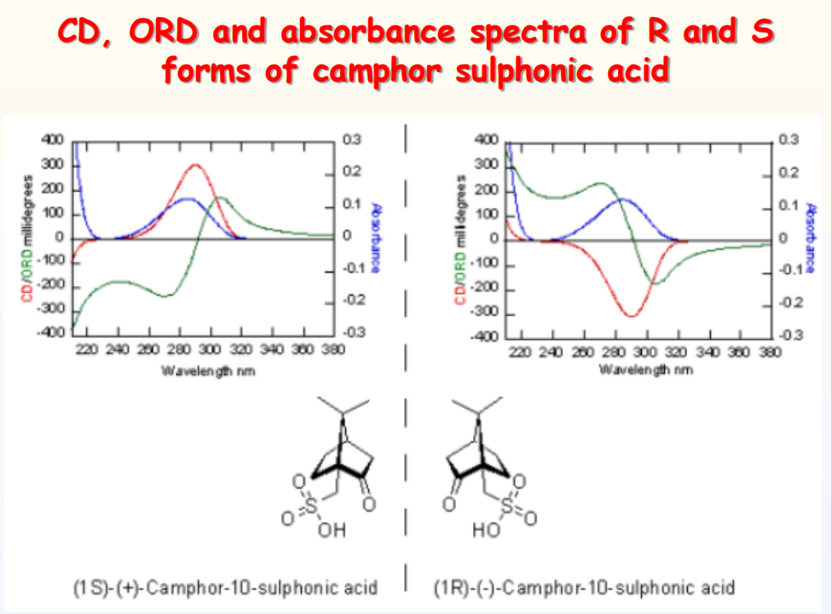

Slide 26
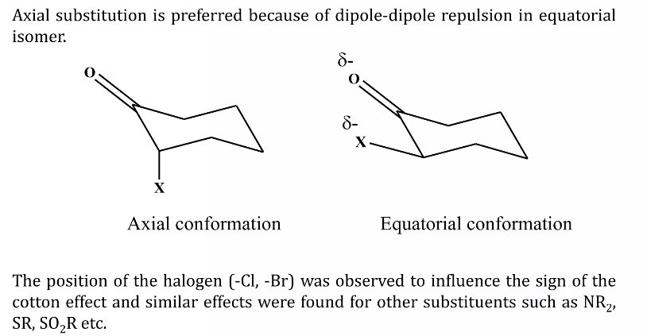
α-Axial haloketone Rule
This rule is applied for ketosteroid that are axially substituted with halogen atom at the α-carbon.

Slide 27
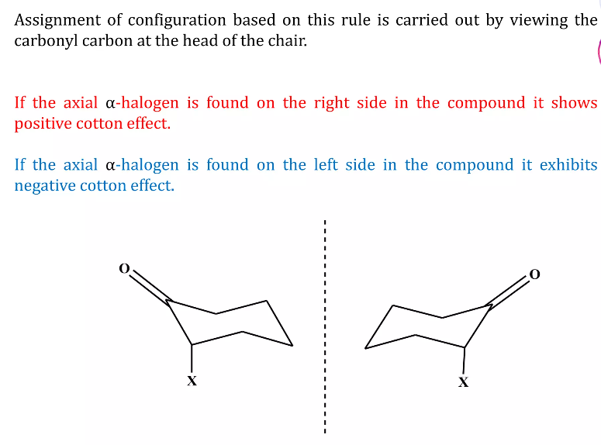

Slide 28
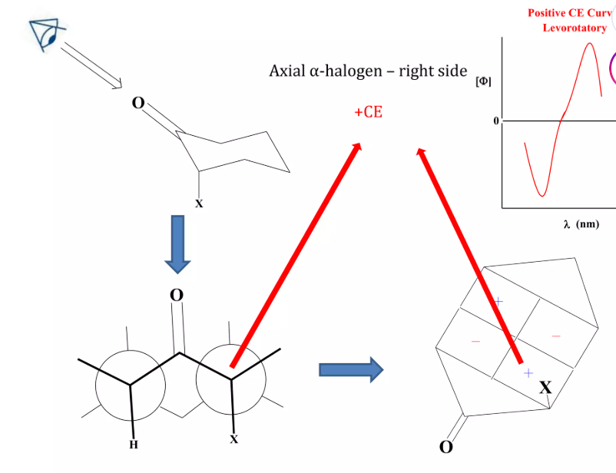

Slide 29
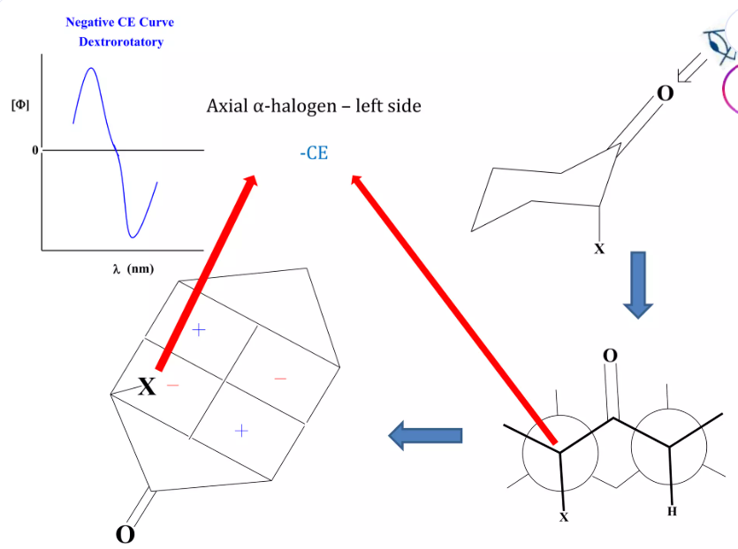

Slide 30
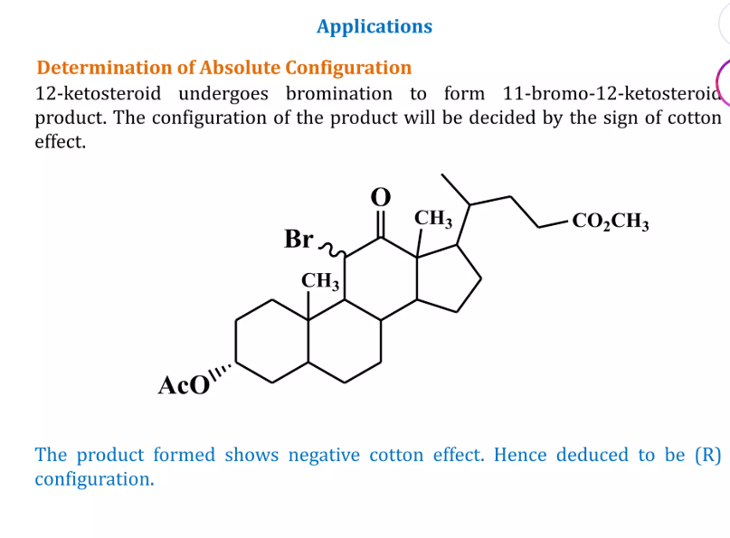

Slide 31
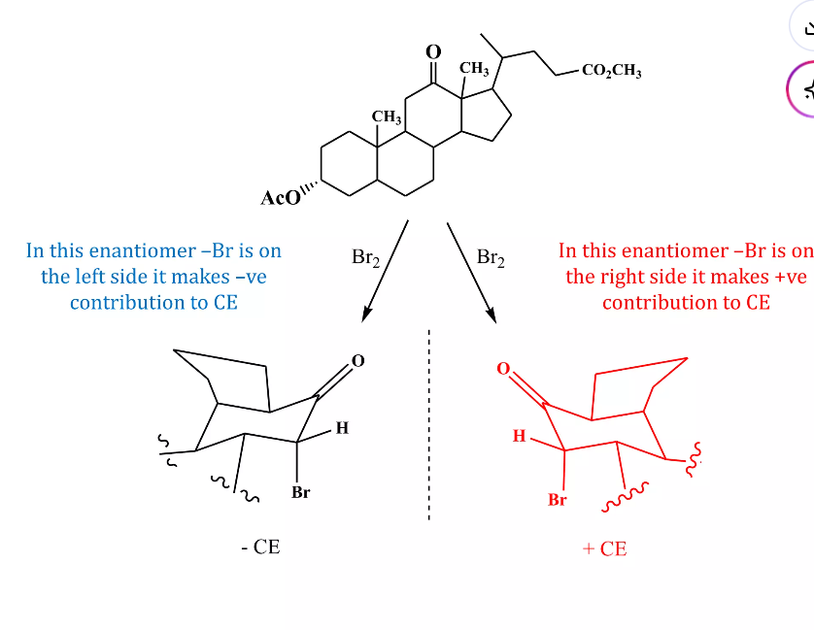

Slide 32
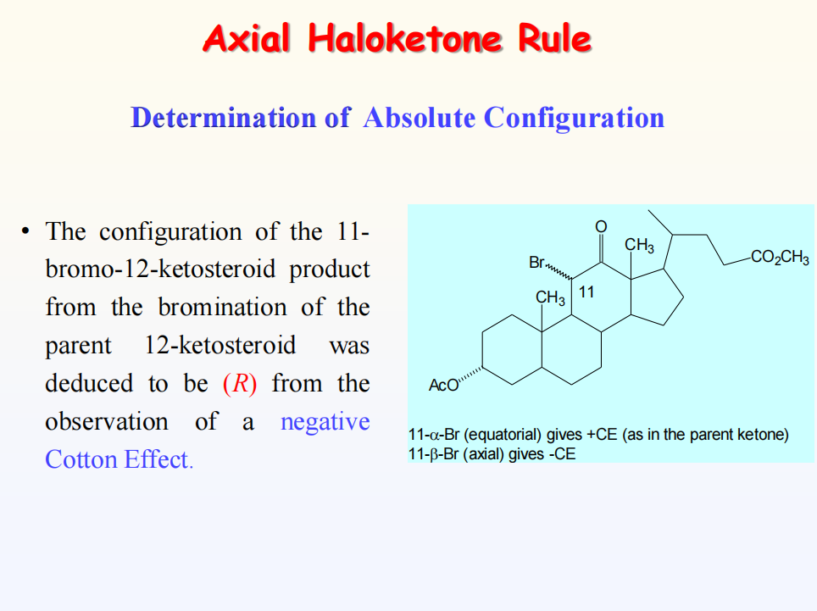

Slide 33
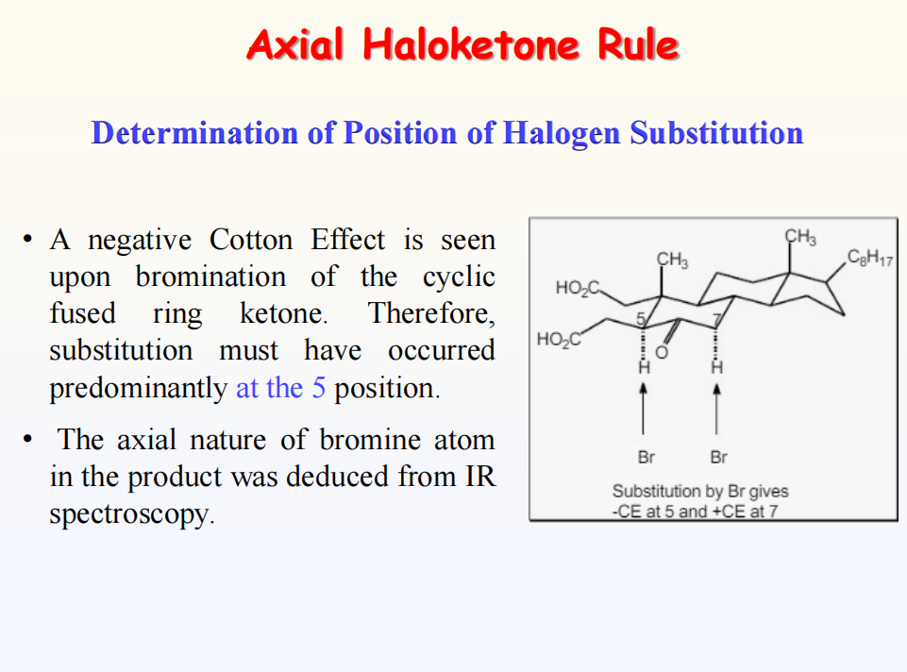

Slide 34
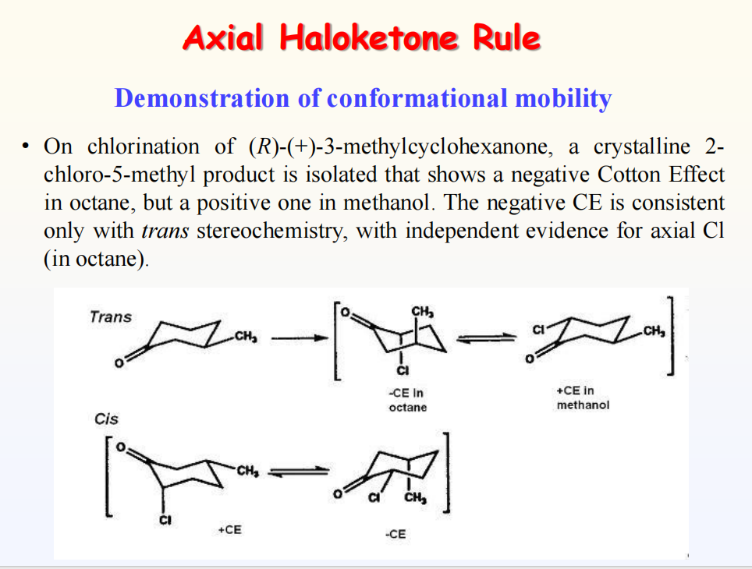

Slide 35
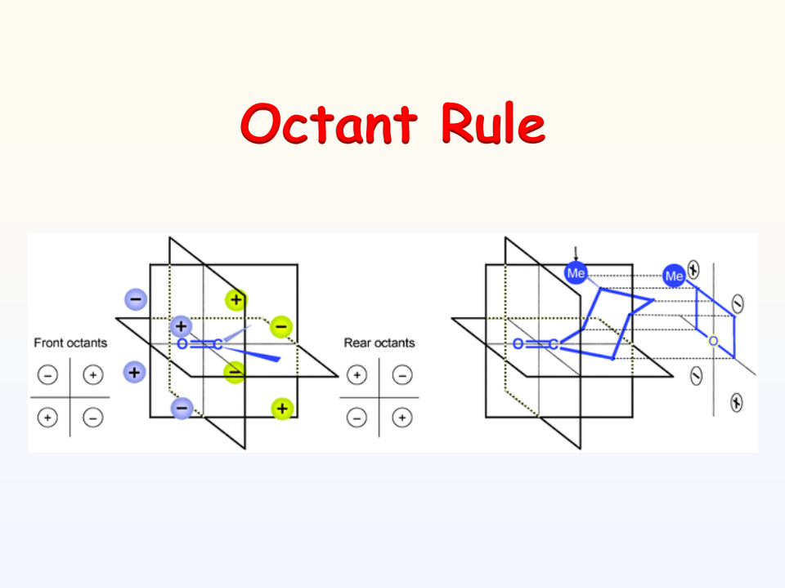

Slide 36
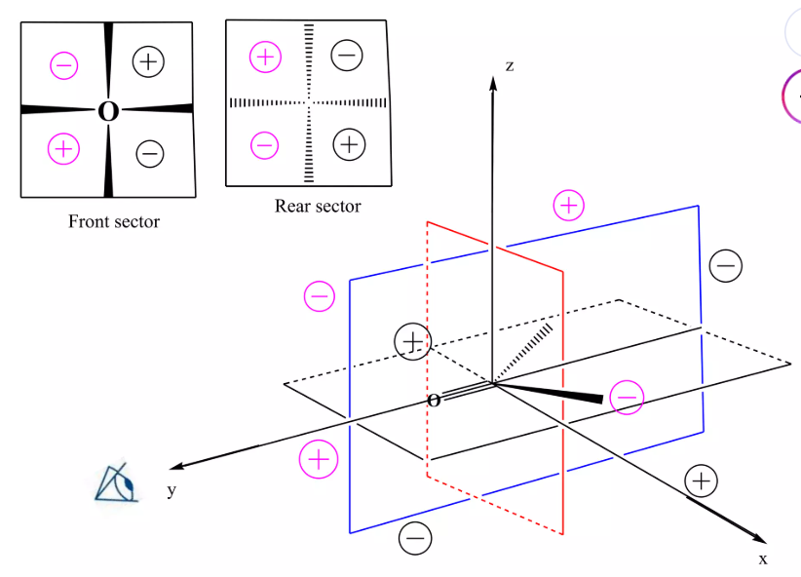

Slide 37
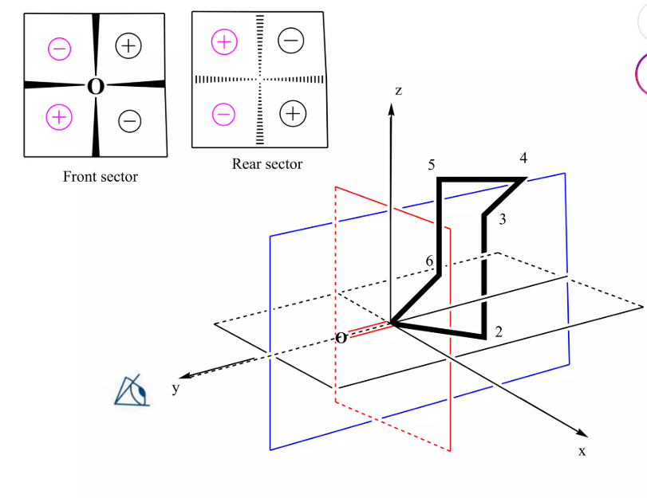

Slide 38
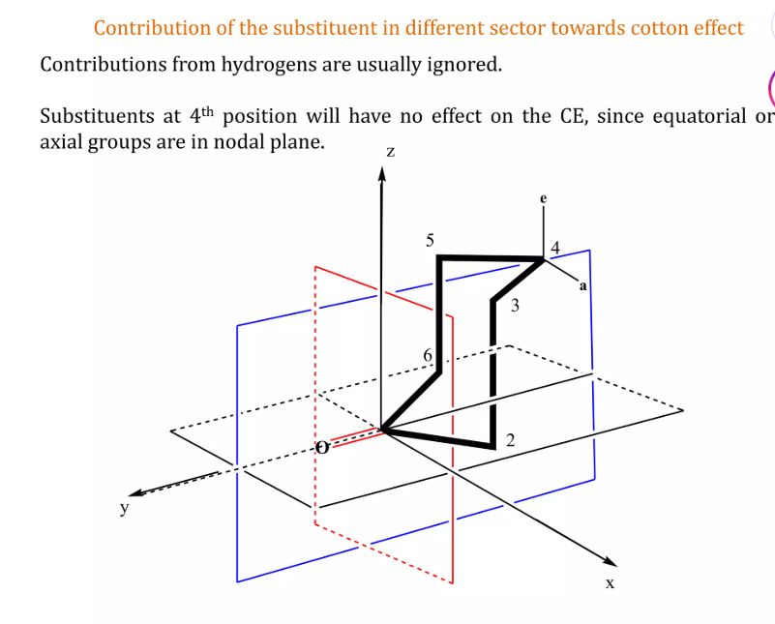

Slide 39
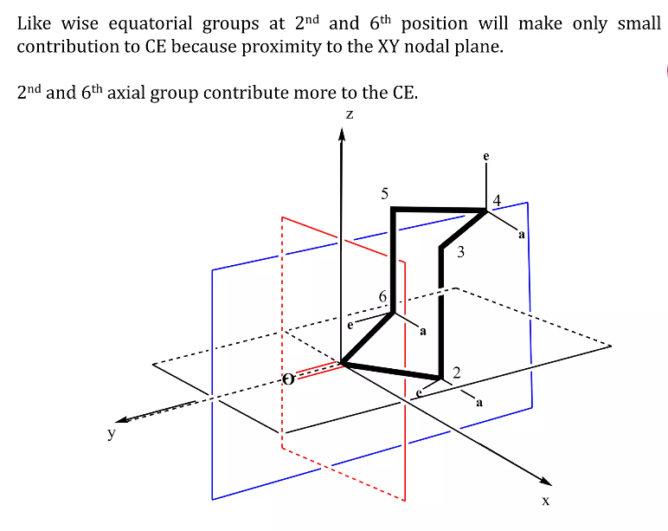

Slide 40
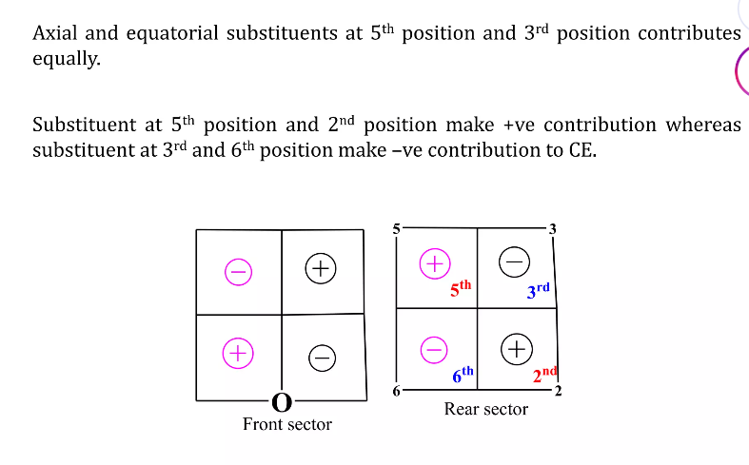

Slide 41
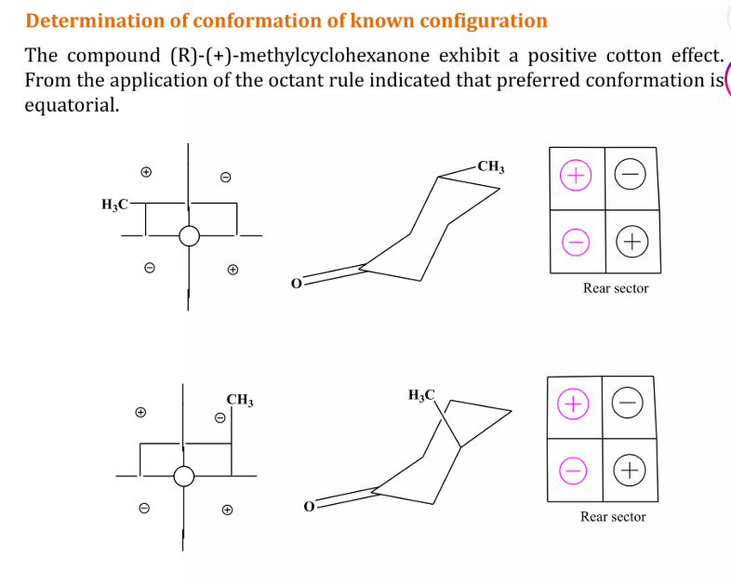

Slide 42
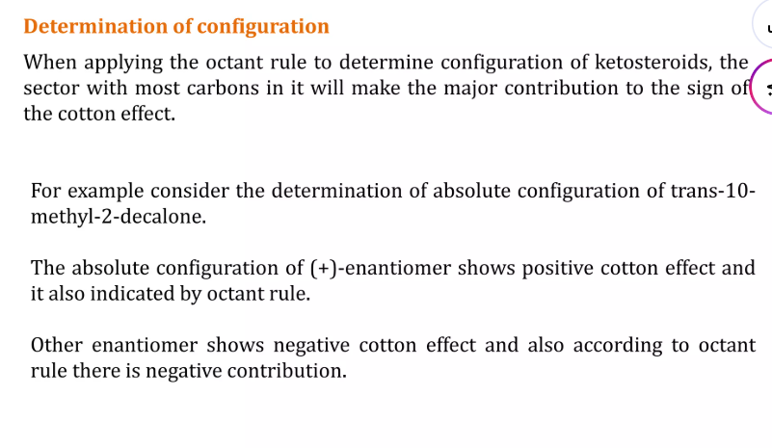

Slide 43
